Slide 1
HostAI: A multi agent approach toward Procedural Content Generation
Isaac Ng

Slide 2
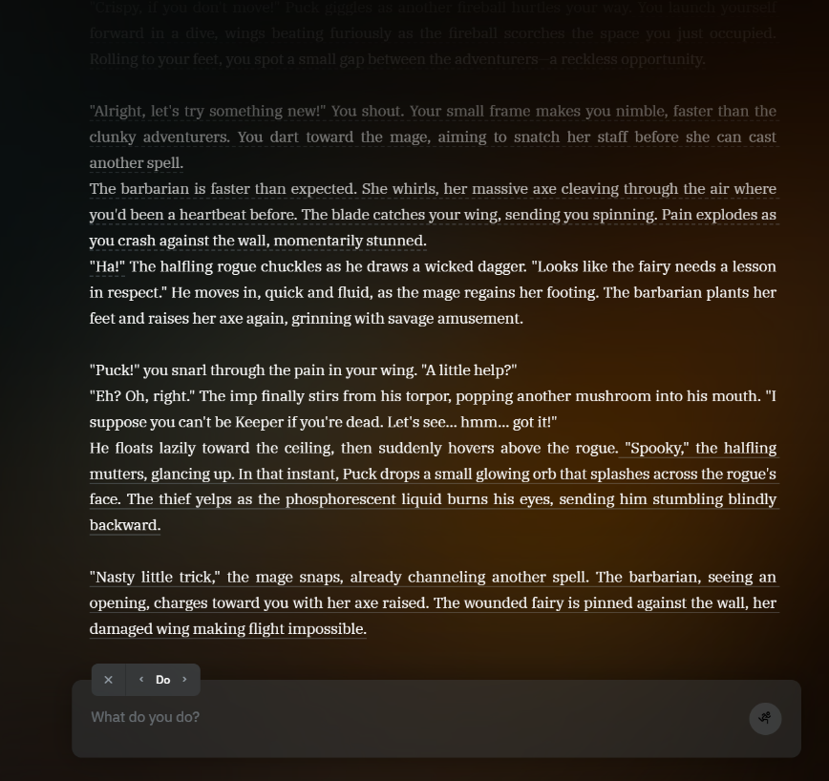
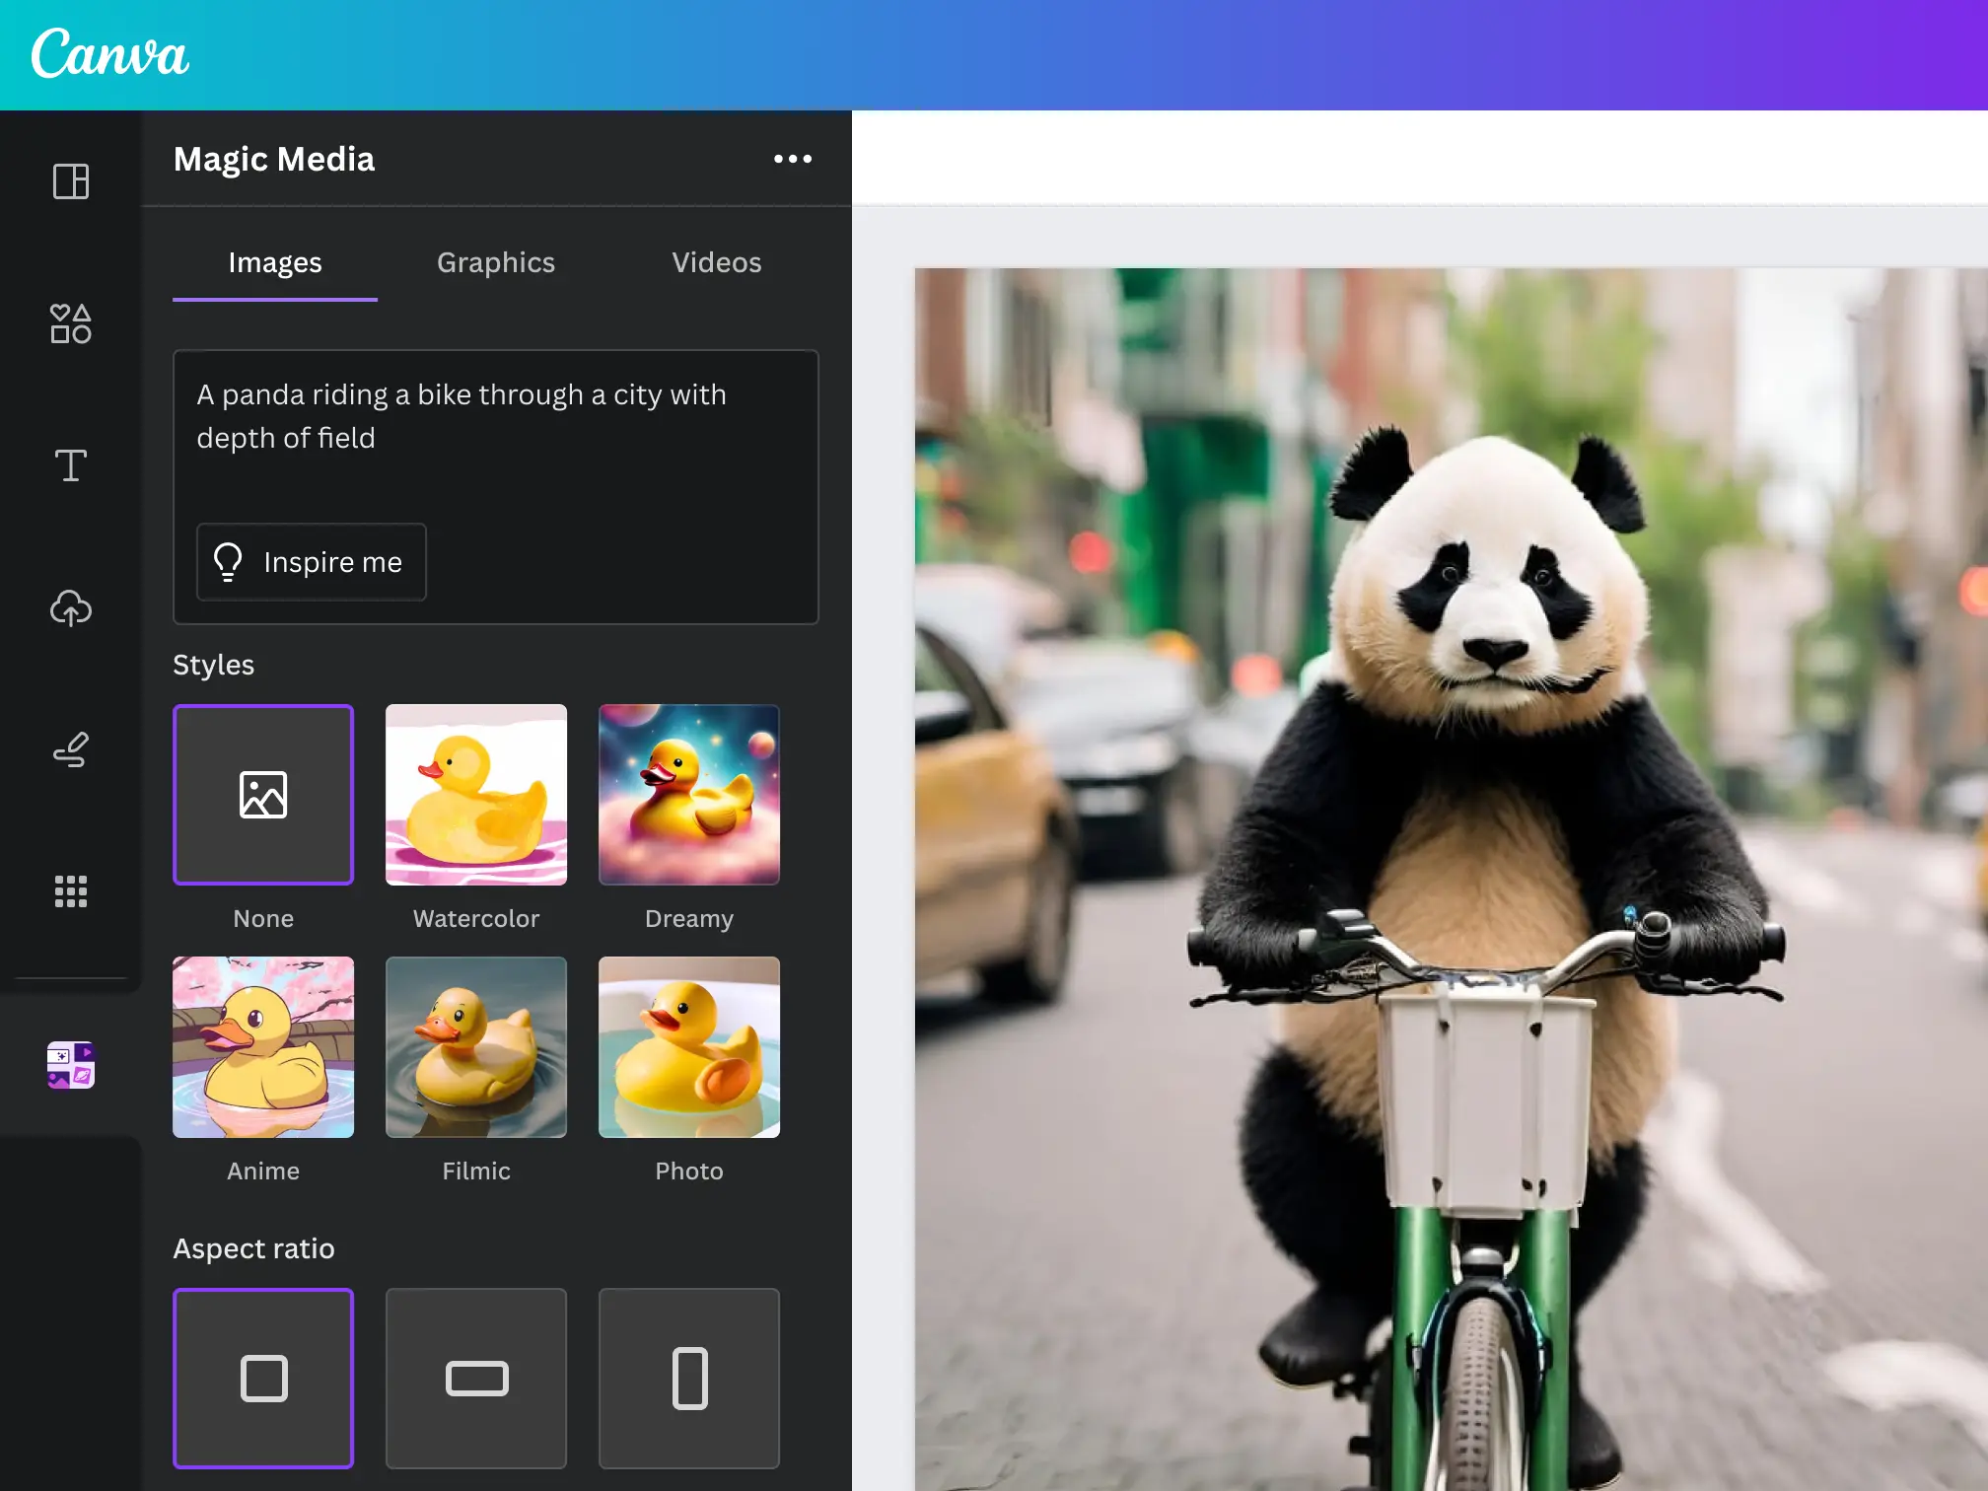
Context
One approach of Gen AI is game content generation
Inconsistence
Hallucination
Confuse with user input
Figure 1. Image generation in Canva
Figure 2. An ongoing game in AI Dungeon

Slide 3
Design Objective
Dynamic generated story
Interactive control on the main character action.
Ensure all action align with rule.
Avoid confusion due to invalid information from user.
Avoid inconsistence in AI-generated information.
Proactive action from non-player character (NPC)

Slide 4
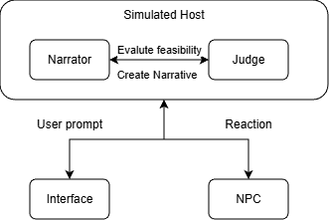
Agents Design
Narrator:
Validate the player's prompt
Extract and structure the action
Generate engaging narratives
Judge:
Validate the action is feasible
Assign an appropriate Difficulty
Evaluate the mechanical consequences
Interface:
Communicate with player
NPCs:
Generate a structured reaction

Slide 5



Implementation – Overview
Technology stack
CrewAI (python)
Each agent act as CrewAI’s crew/flow
MongoDB (docker)
Embed vector index for game rule and campaign data
ChatGPT 5o mini
Benefit
Retrieval-Augmented Generation (RAG) for consistence
Internal state for consistence
Separate functionality to maximize the factuality and proactiveness

Slide 6
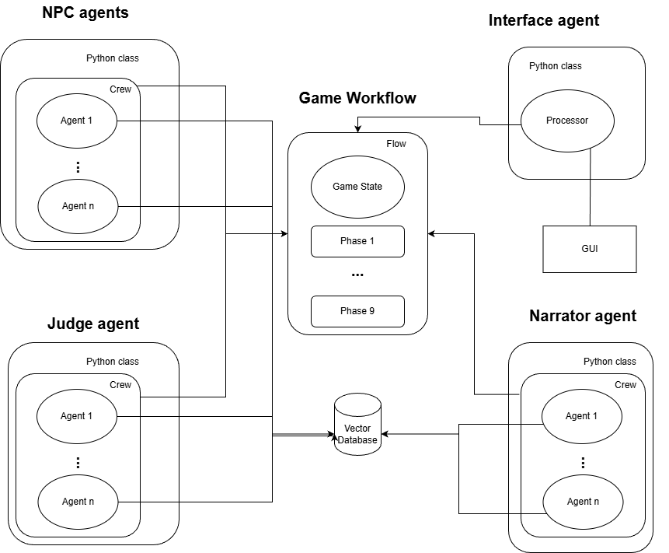
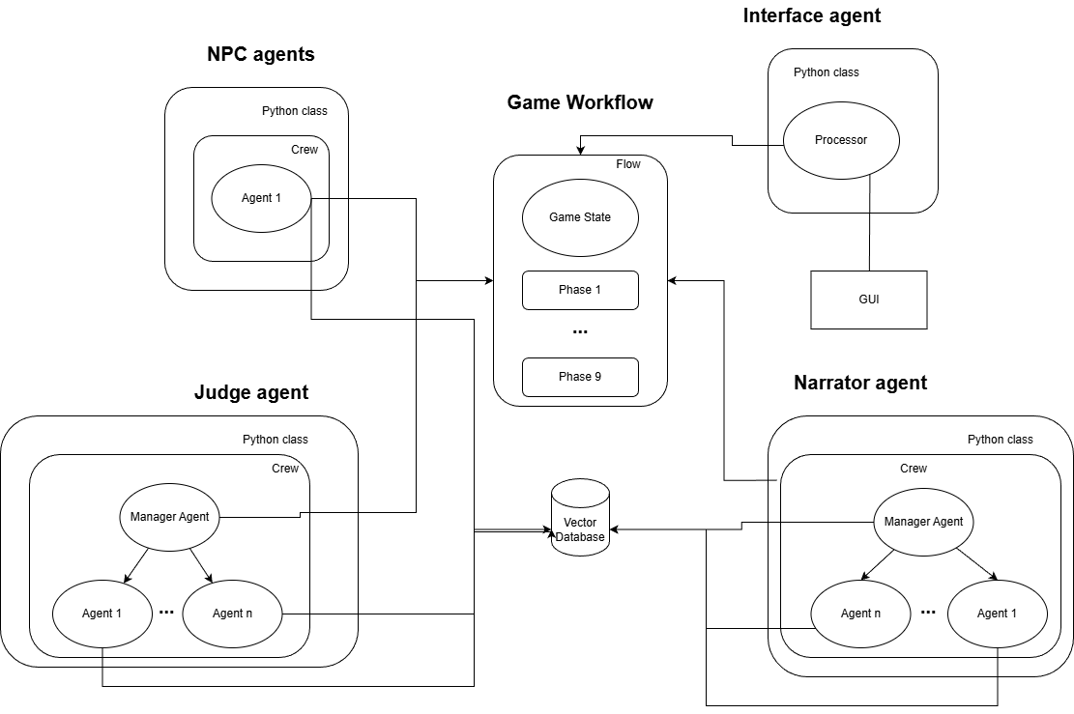
Collaboration Implementation Iteration 1 &2
Flow + Crew (sequential)
Flow + Crew (hierarchical)

Slide 7
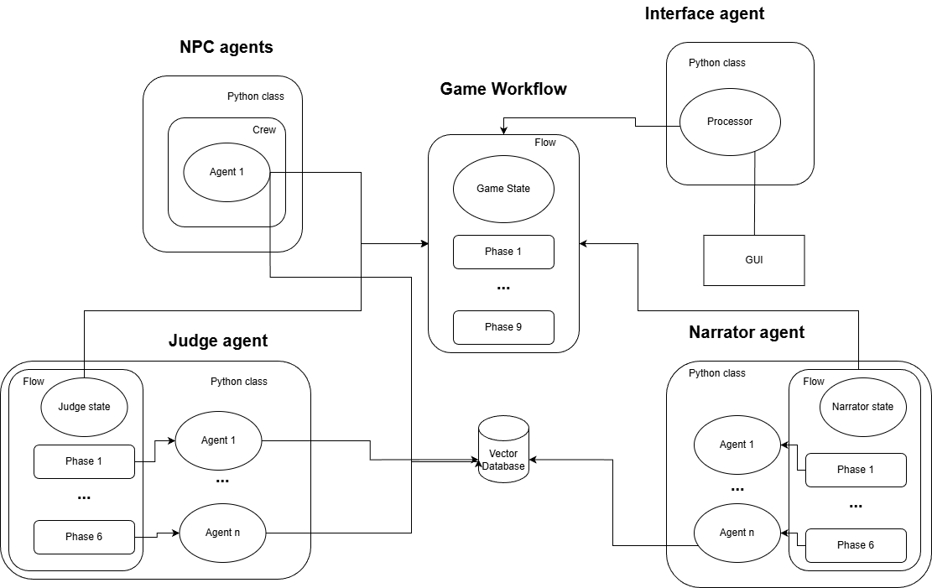
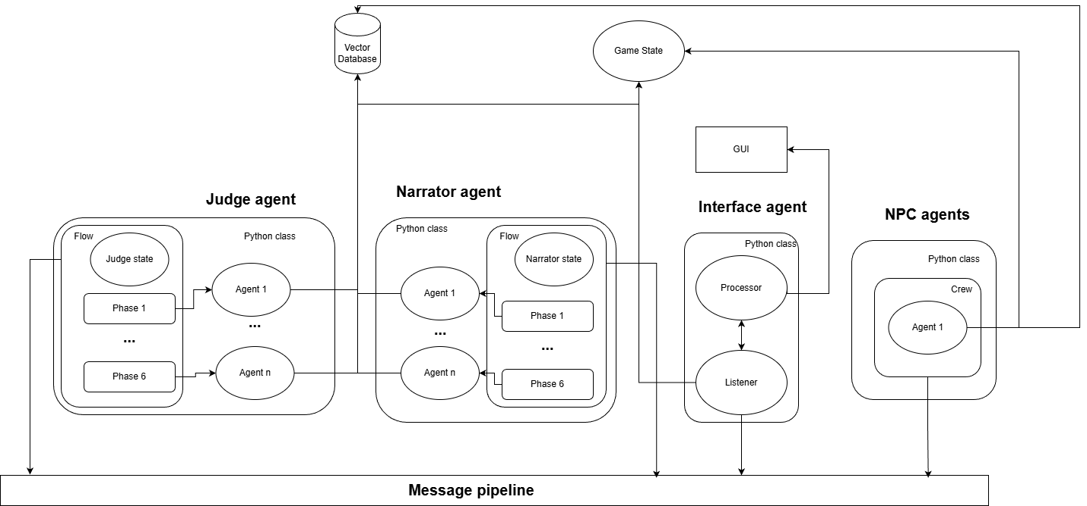
Collaboration Implementation Iteration 3 &4
Flow + Flow
Message + Flow

Slide 8
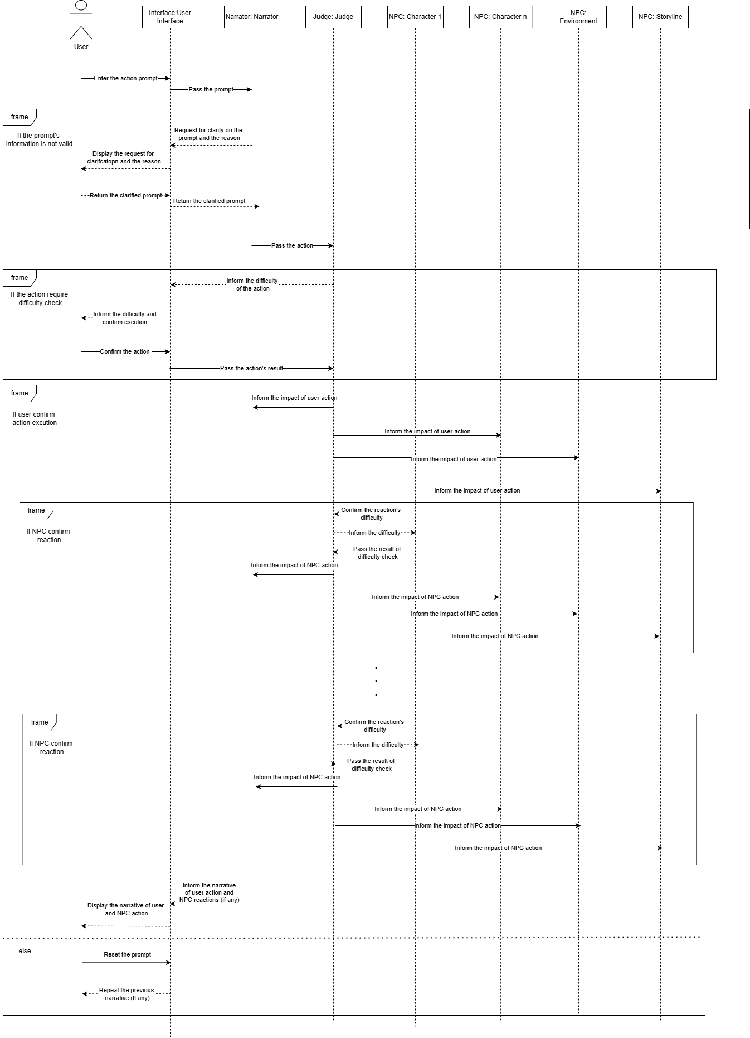
Message Sequence
Sender | Receiver | Receiver’s Task
Interface | Narrator | Validate and extract action
Narrator | Judge | Check feasibility and assign difficulty
Judge | Interface | Difficulty Check
Interface | Judge | Evaluate the impact/consequence
Judge | NPC | Evaluate reaction
NPC | Judge | Evaluate reactions’ consequence
NPC | Narrator | Create narrative
Narrator | Interface | Display narrative

Slide 9
Demo

Slide 10
Result & Limitation
Dynamic generated story
Validate all action align with rule.
Avoid confusion due to invalid information from user.
Proactive action from non-player character (NPC)
Latency (3-5 minute)
Unstable (many unexpected behaviour)
Limited consistence (restricted by the state)
Limited behavior (communication, attack, investigation)

